Slide 1
DATA SCIENCE PROJECT PORTFOLIO
BY JOVITA ANDREWS | SUID: 522110149
Notes:
Hi everyone! My name is Jovita Andrews. And this is my data science portfolio

Slide 2
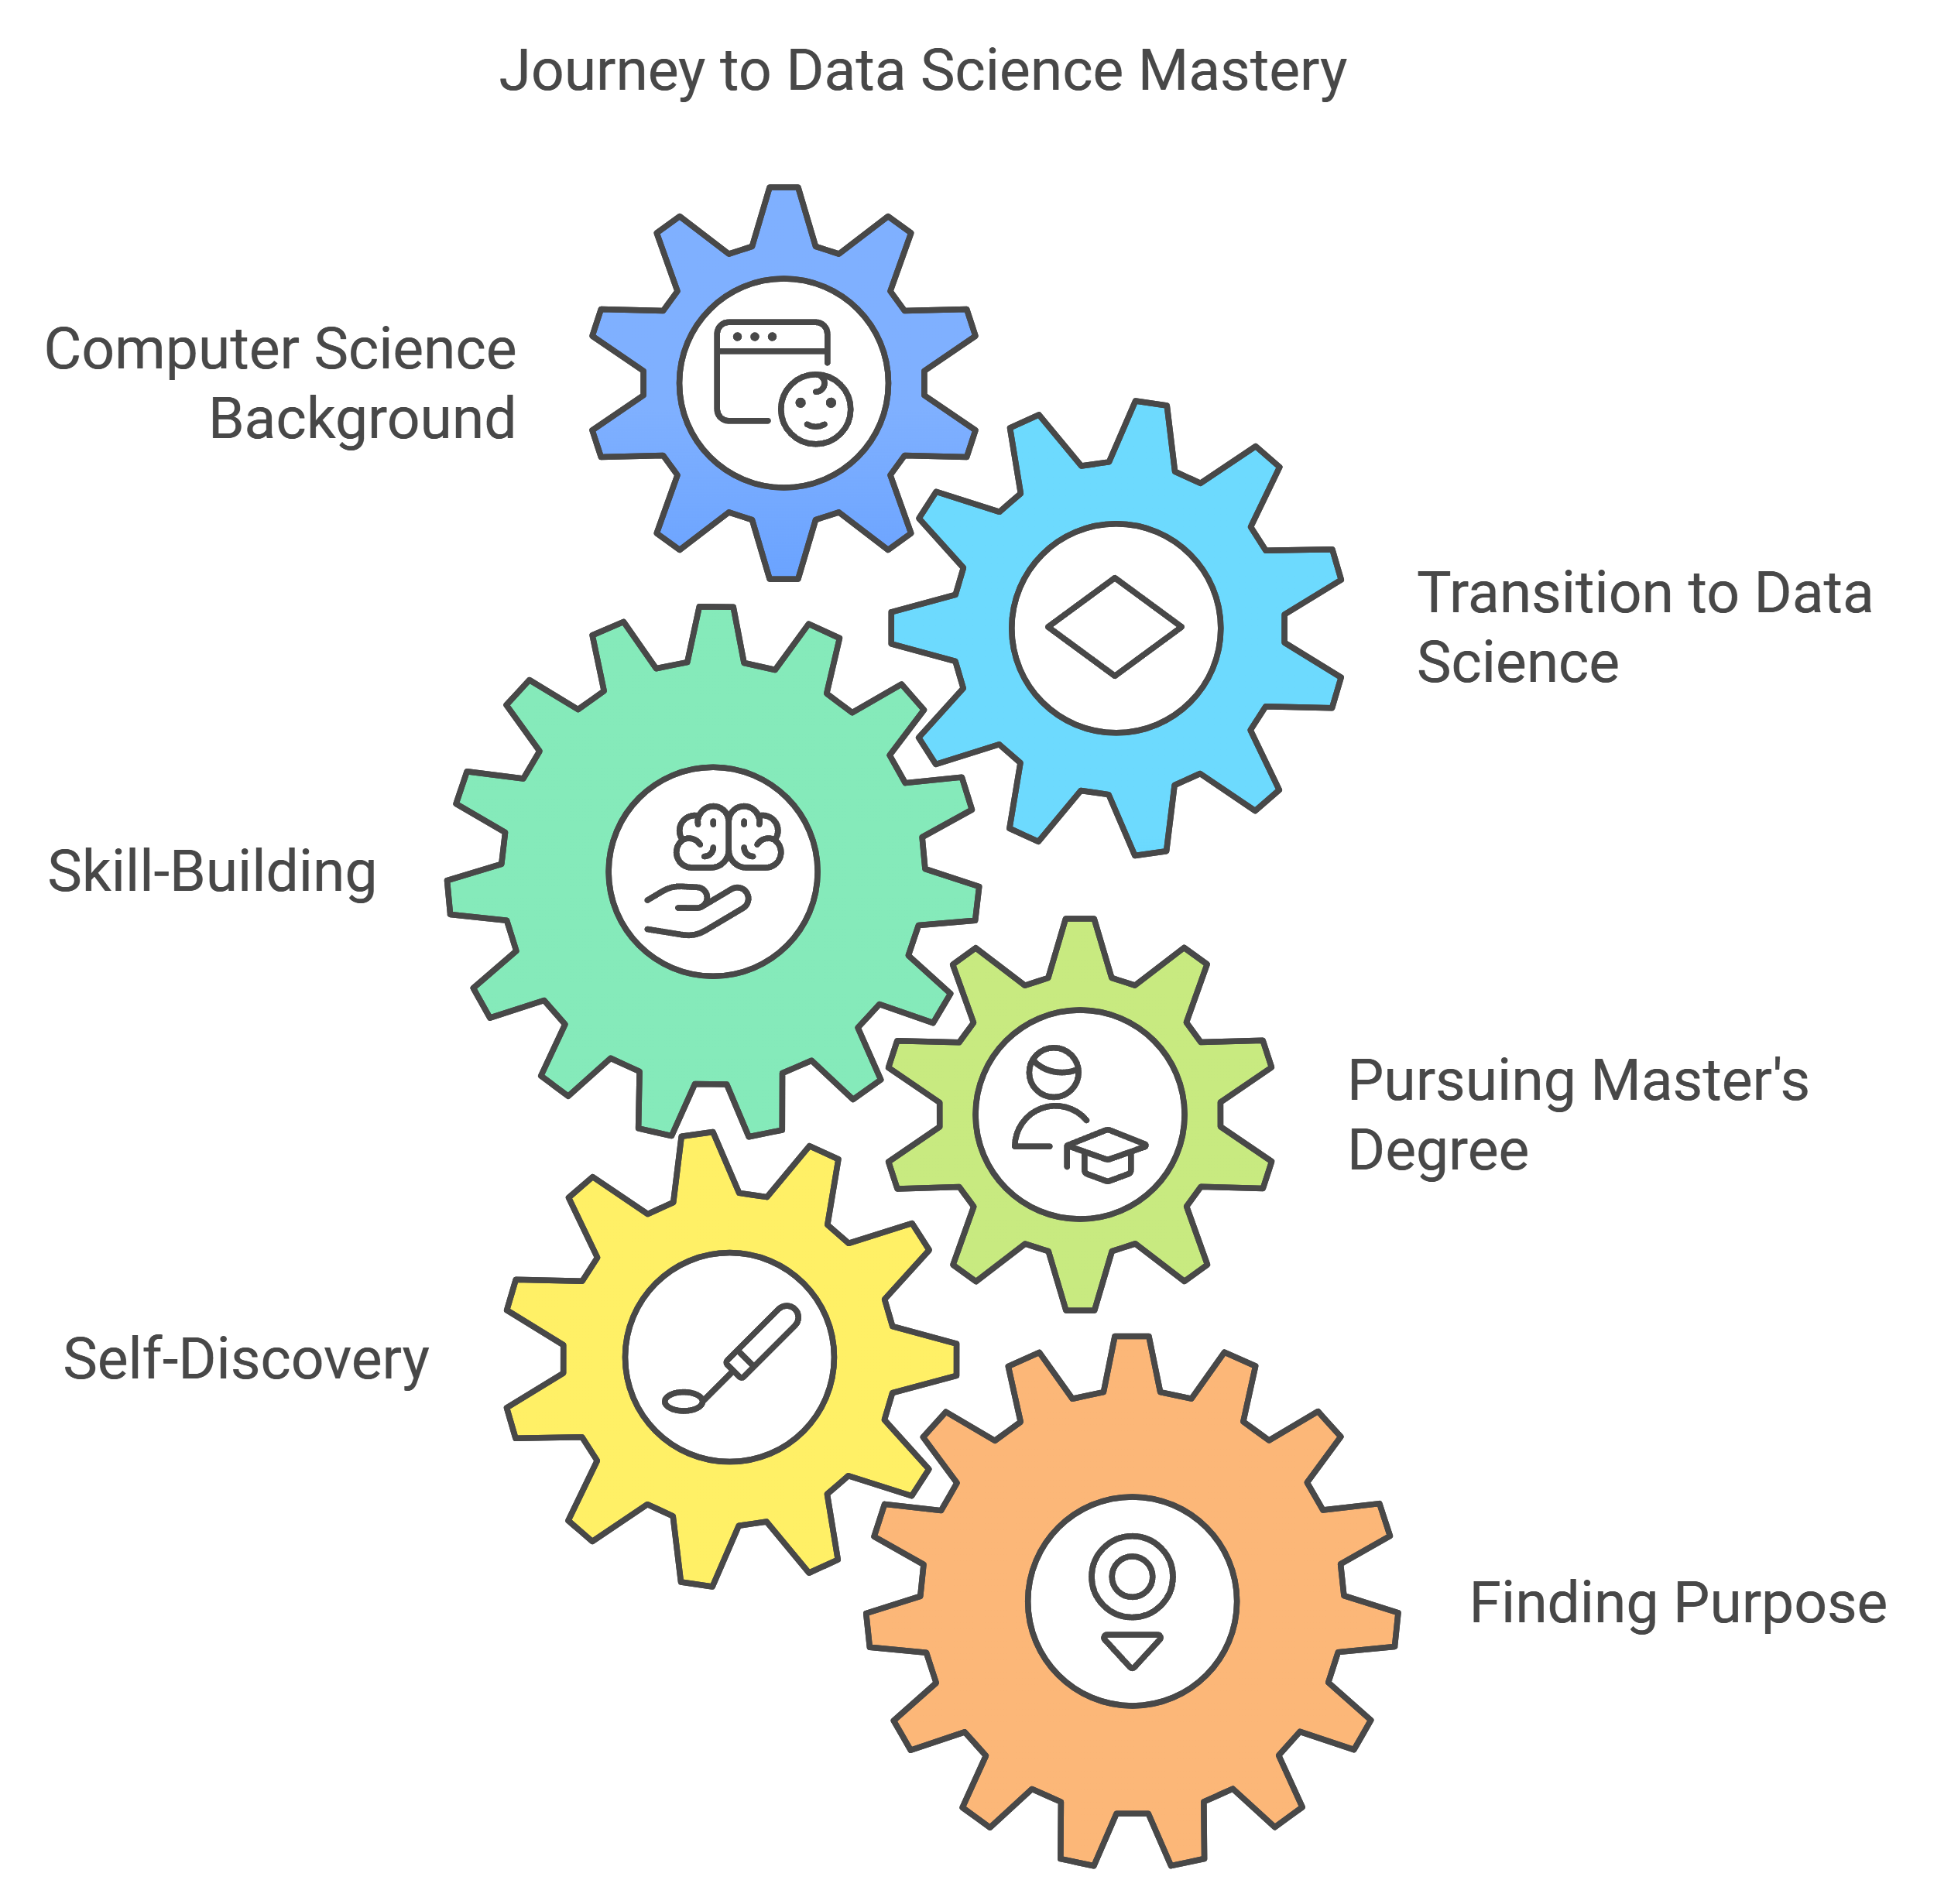
Notes:
I’m here to share my journey from a background in Computer Science and Engineering to a Master’s in Applied Data Science at Syracuse University. This path was about more than just pursuing a degree; it was a journey of self-discovery, skill-building, and finding purpose in the world of data science.

Slide 3
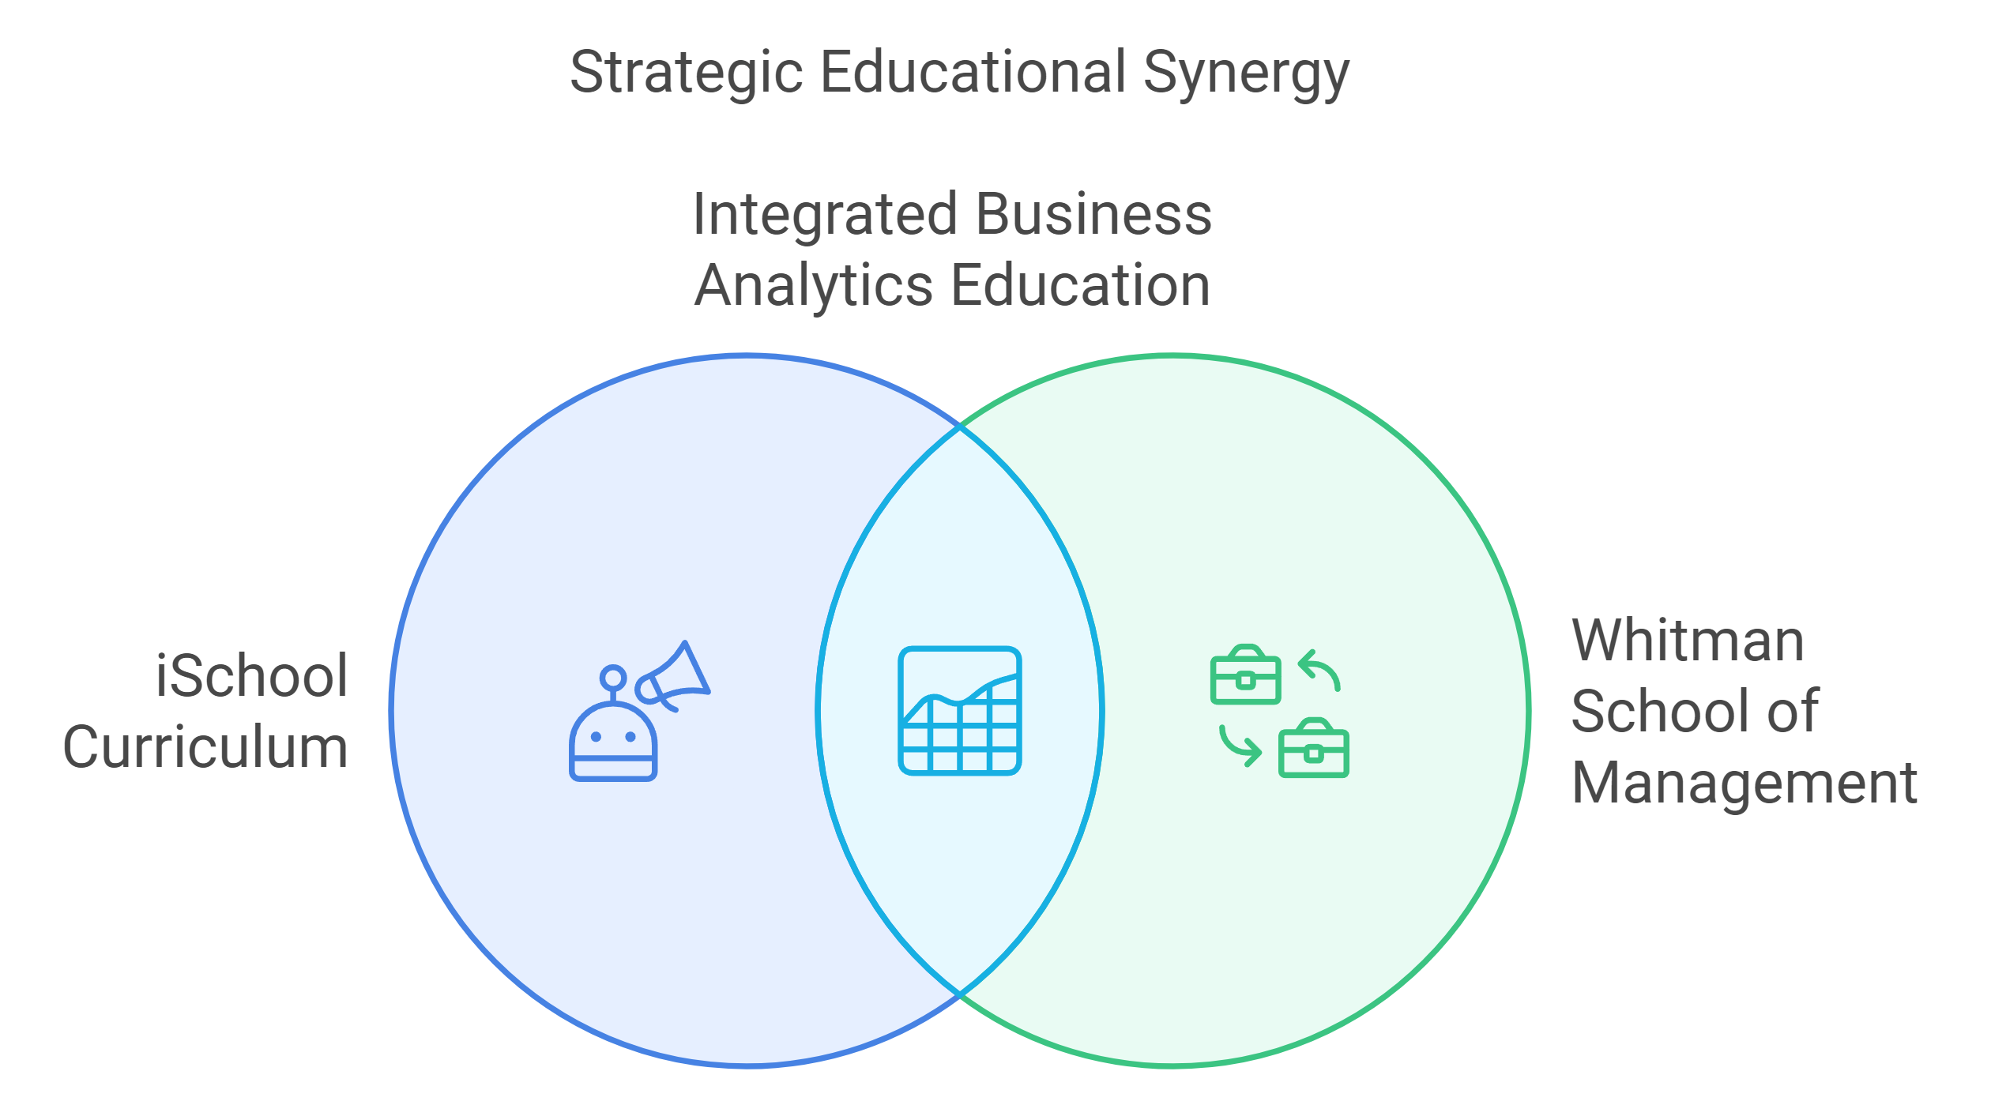
Notes:
When I began exploring graduate programs, Syracuse’s iSchool stood out. I was drawn to the program's structured curriculum, with specialized tracks in areas like AI, Big Data, and Business Analytics. The collaboration with the Whitman School of Management added a unique, business-oriented dimension, which was essential in preparing me for the competitive job market.

Slide 4
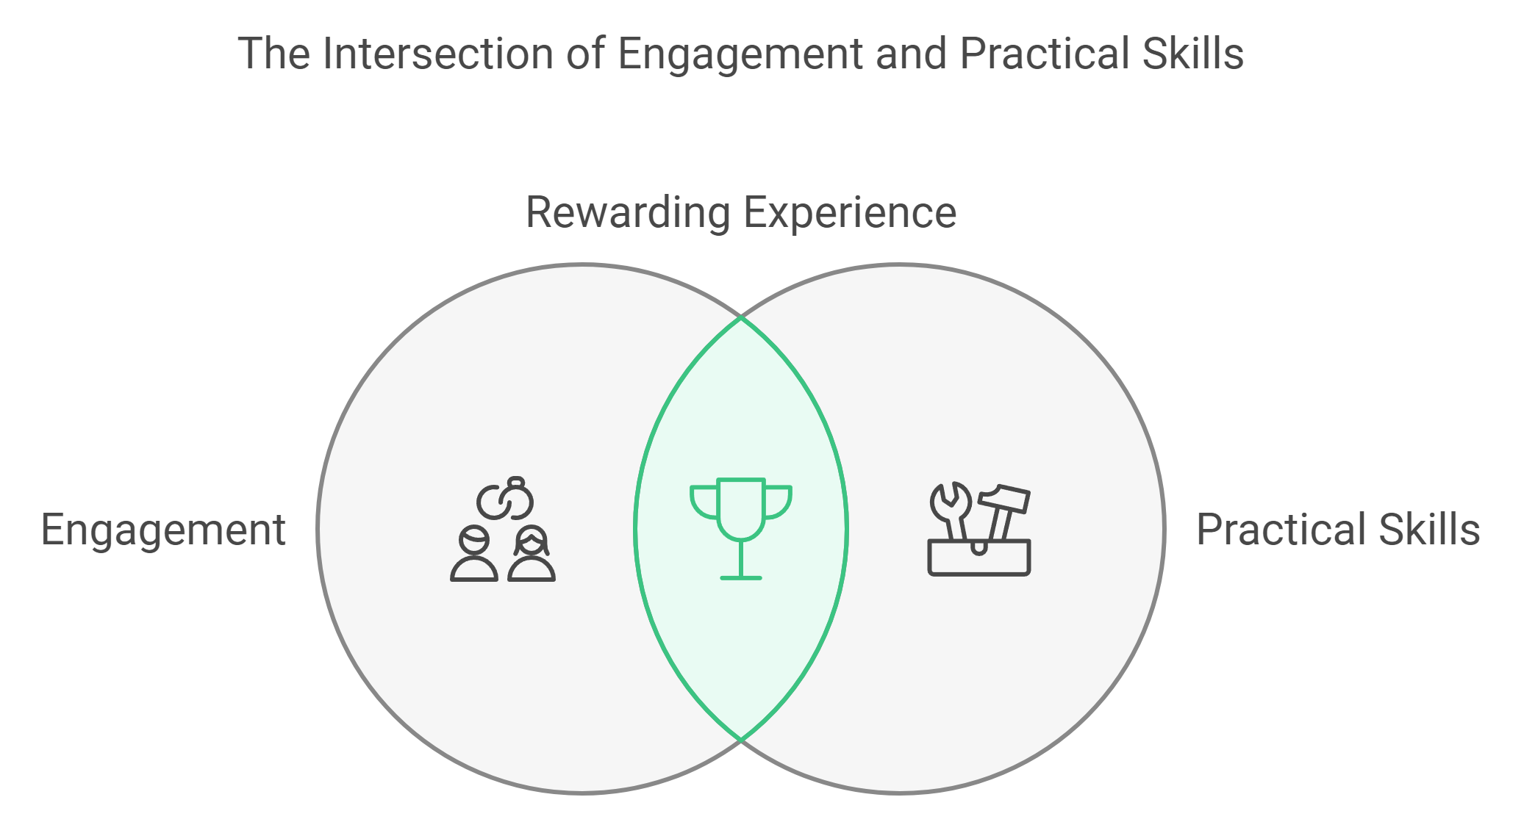
Notes:
One of the best experiences was Professor Donald Harter’s Business Analytics class. His quick wit and enthusiasm kept me engaged for hours and laid a solid foundation for the rest of my courses. Though navigating the challenges of Whitman’s courses was intense, they were also rewarding, giving me practical skills and insights.

Slide 5
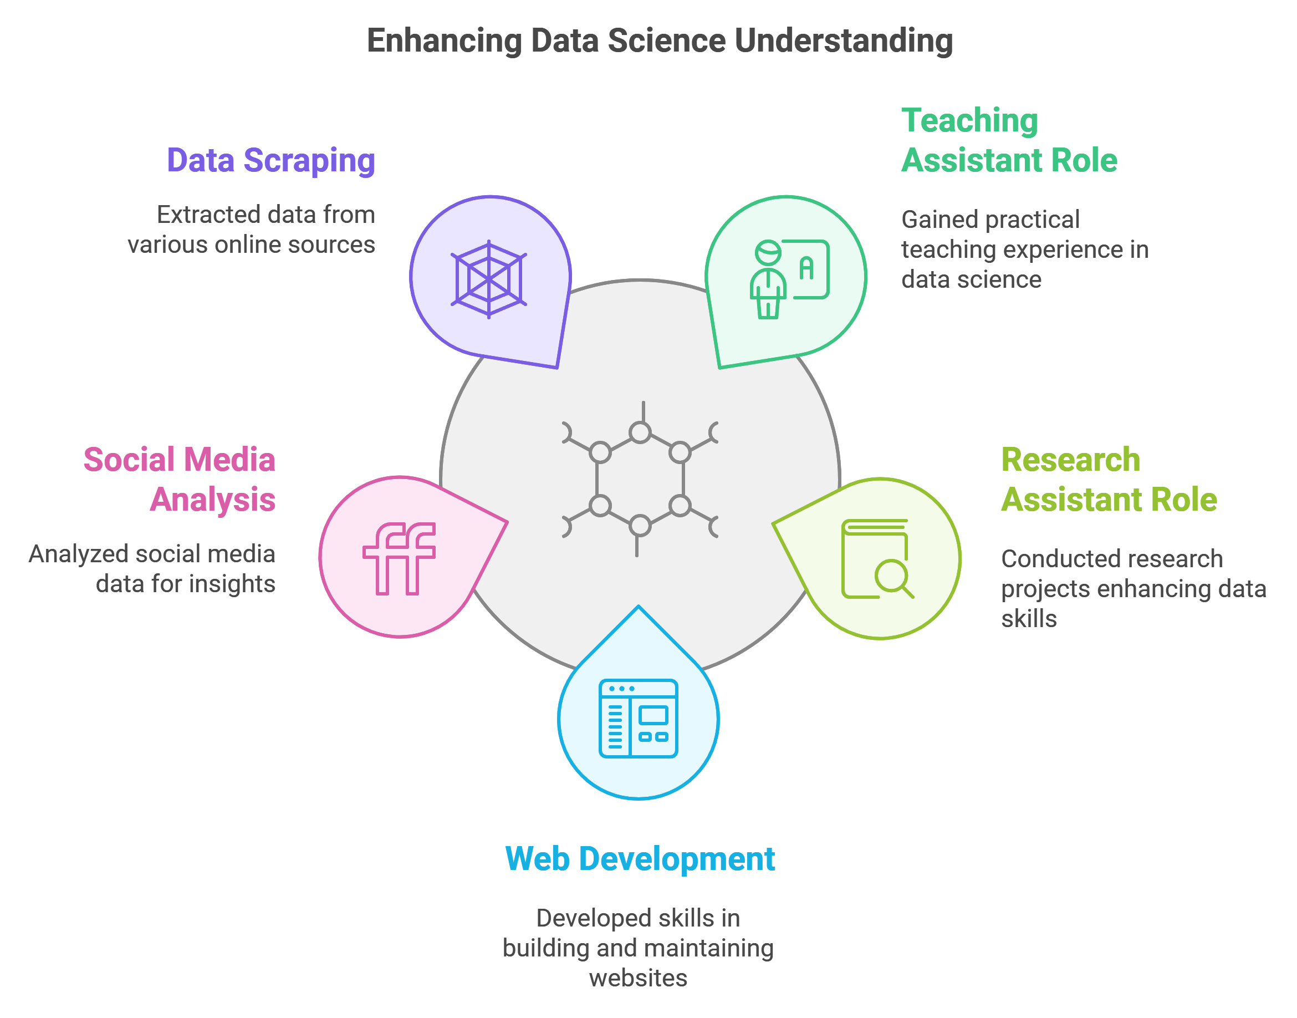
Notes:
My time at Syracuse wasn’t limited to academics. As a Teaching Assistant and Research Assistant, I gained hands-on experience in web development, social media analysis, and data scraping. These roles enhanced my understanding of data science in practical contexts, from social interactions on Twitter to supporting entrepreneurship projects.

Slide 6
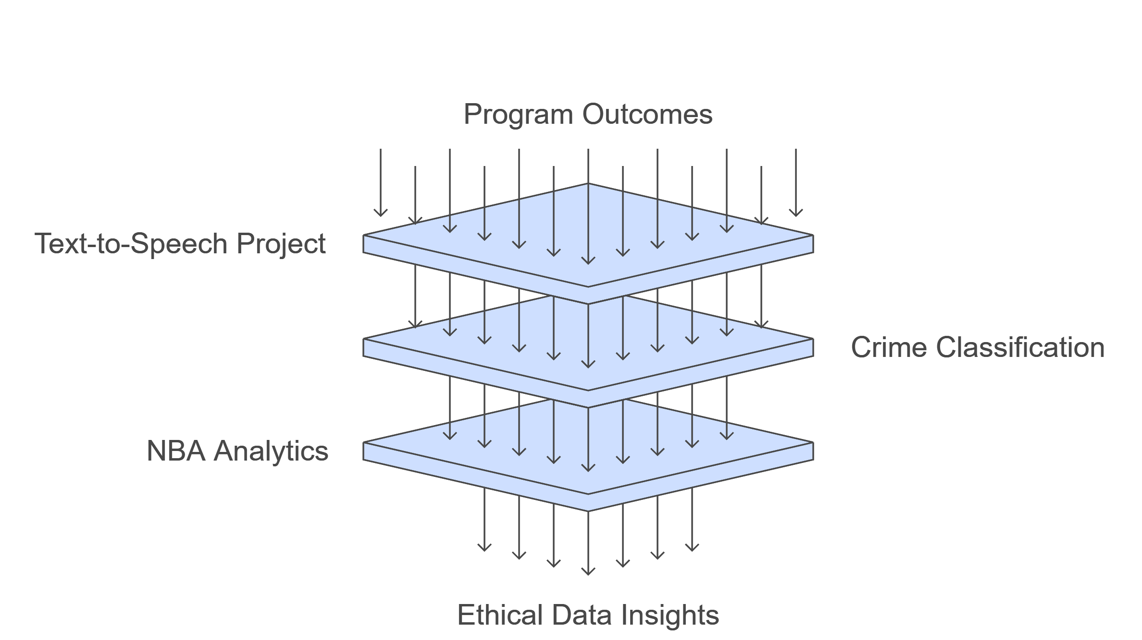
Notes:
The program’s outcomes guided my learning path. I worked on diverse projects like the Text-to-Speech Converter using AWS, Crime Classification for public safety, and NBA Analytics. Each project challenged me to collect and analyze data, communicate insights effectively, and address ethical considerations in data science.

Slide 7
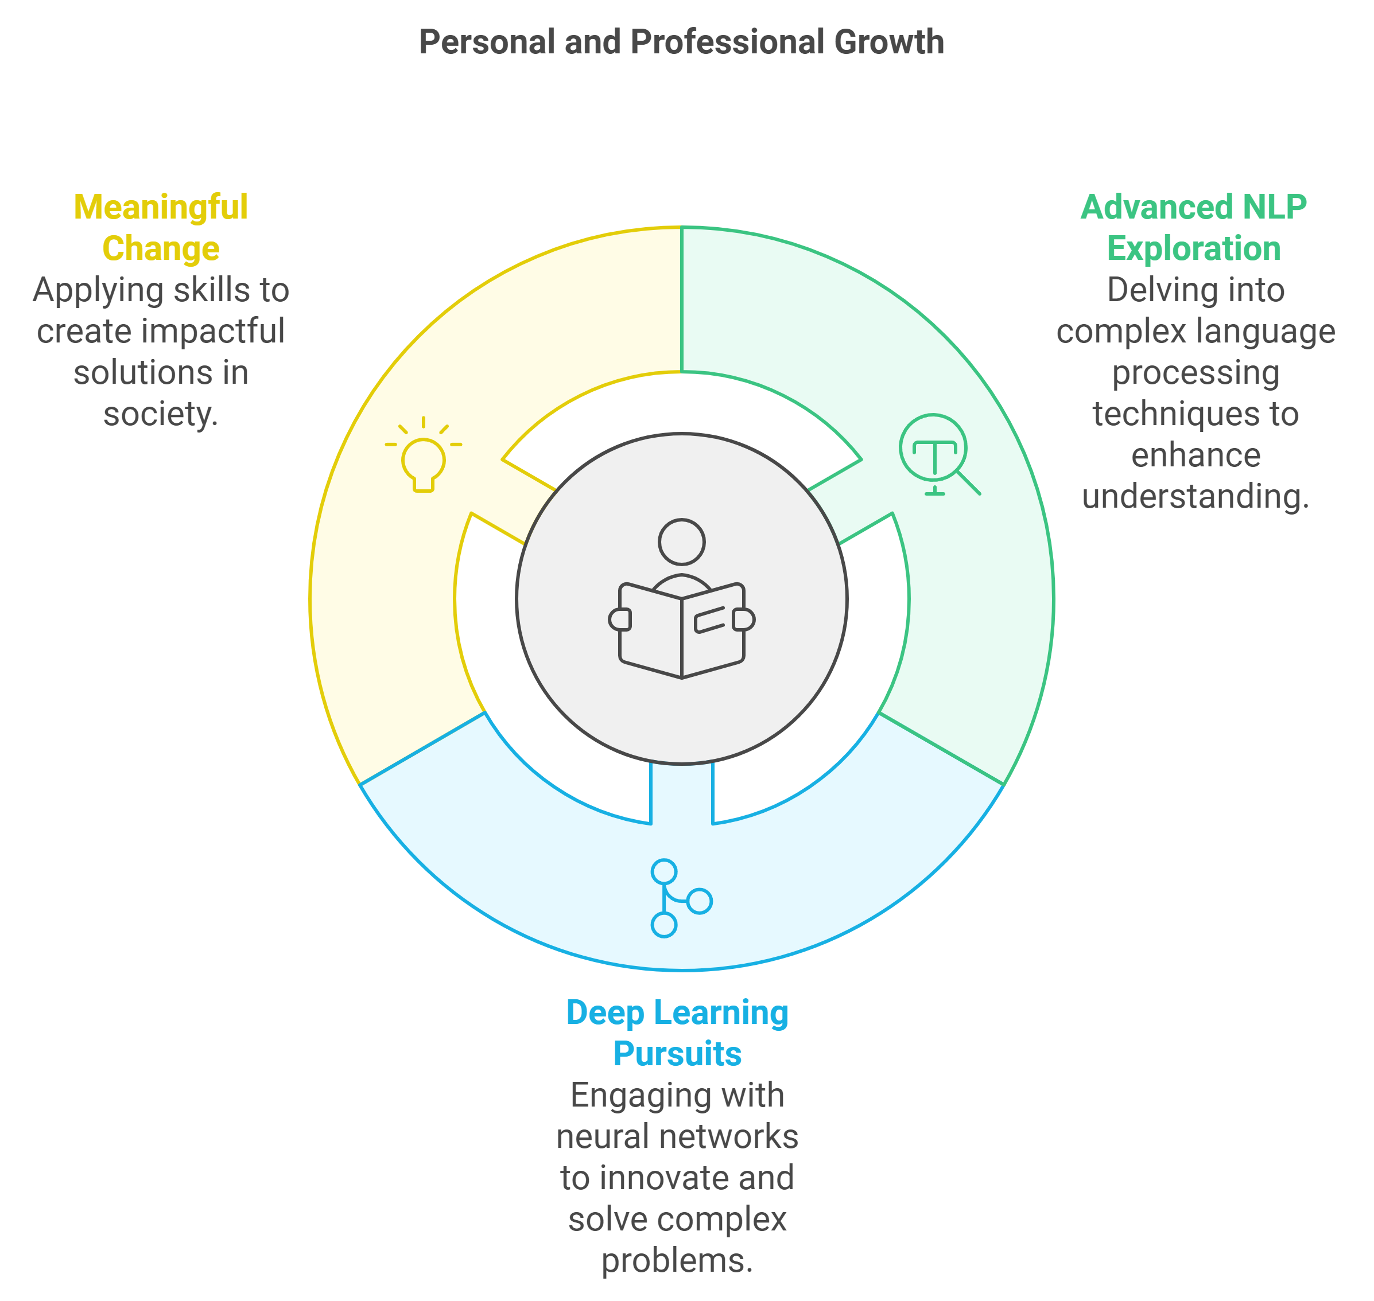
Notes:
Looking back, the iSchool’s emphasis on ethics and flexibility has profoundly impacted my view of data science. While I encountered hurdles, like petitioning for courses, the experience taught me resilience. I’m excited to continue exploring advanced NLP and deep learning, using my skills to drive meaningful change.

Slide 8
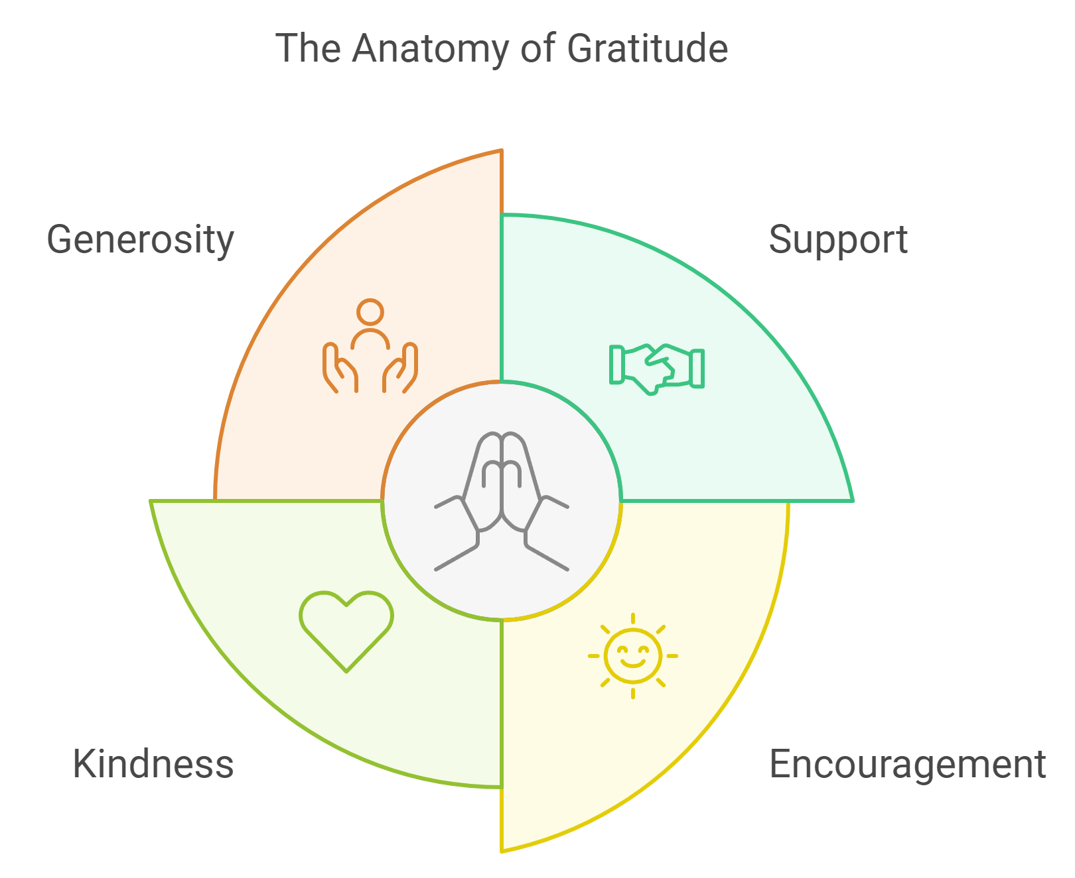
Notes:
Thank you for listening to my journey. This program has shaped me into a confident data scientist, ready to make an impact. I’m excited about the road ahead and look forward to contributing to data-driven solutions with purpose and integrity.

